Slide 1


CLEAN CODE Fresher training

Slide 2
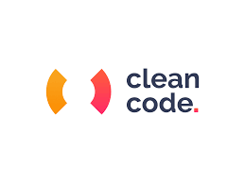
Clean code
Code is clean if it can be understood easily – by everyone on the team.
Clean code can be read and enhanced by a developer other than its original author.
Understandability
Readability
Changeability
Extensibility
Maintainability

Slide 3
Clean code
General rules

Slide 4
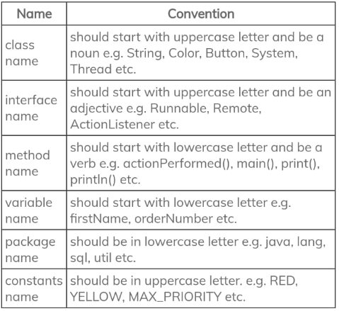
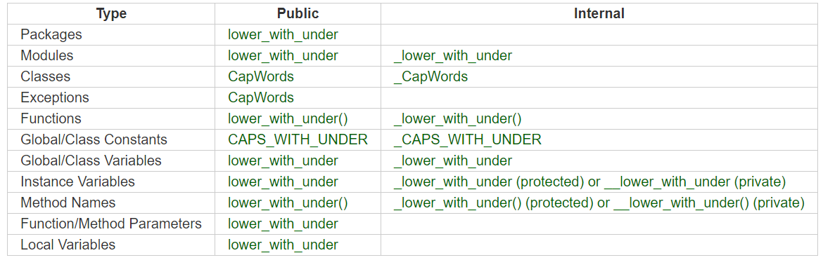
General rules
Follow standard conventions
Python naming conventions
Java naming conventions

Slide 5
General rules
Follow standard conventions
Python naming conventions
Java naming conventions

Slide 6
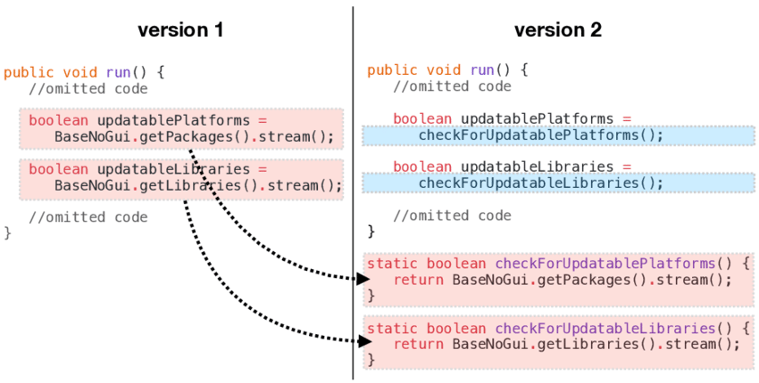

General rules
Keep it simple stupid. Simpler is always better. Reduce complexity as much as possible

Slide 7
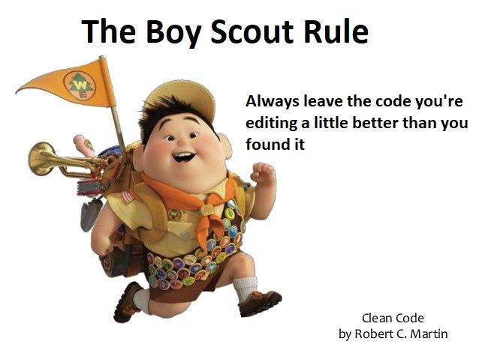
General rules
Boy scout rule. Leave the campground cleaner than you found it.

Slide 8


General rules
Always find root cause. Always look for the root cause of a problem.

Slide 9
Clean code
Design rules

Slide 10
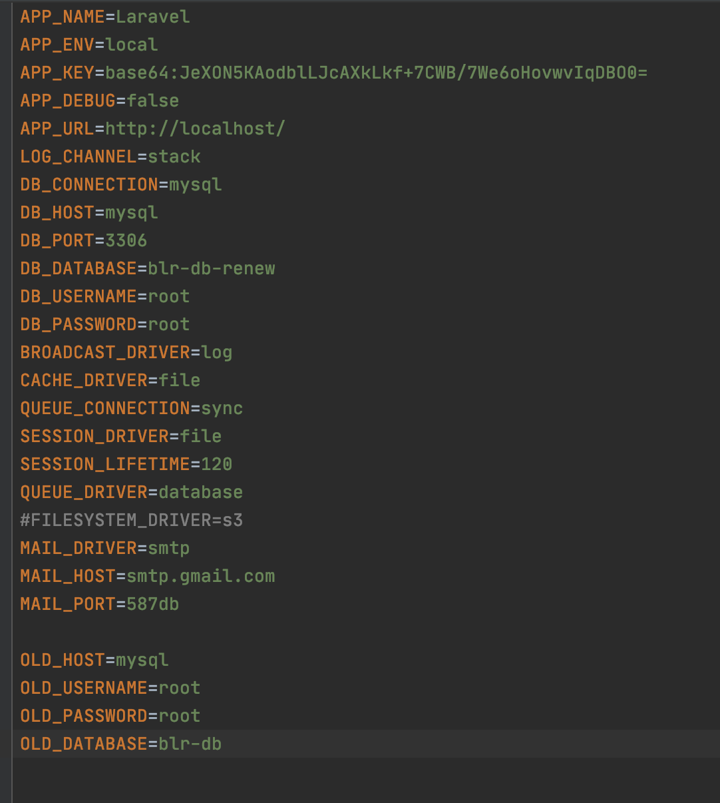
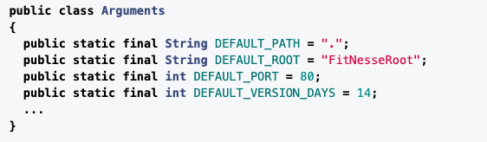
Design rules
Keep configurable data at high levels.

Slide 11
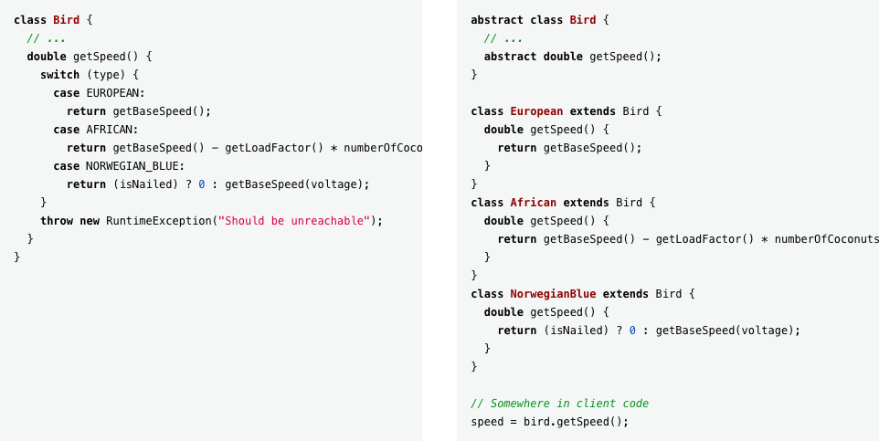
Design rules
Prefer polymorphism to if/else or switch/case

Slide 12
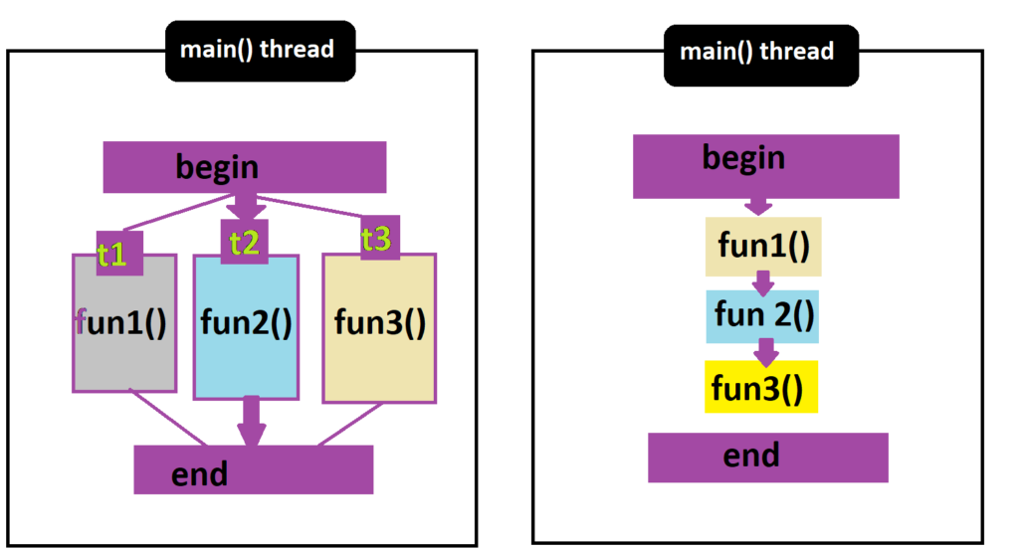
Design rules
Separate multi-threading code

Slide 13
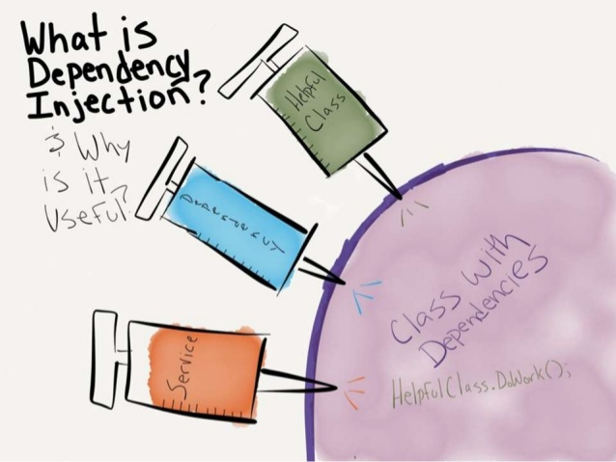
Design rules
Use dependency injection

Slide 14

Design rules
Follow Law of Demeter. A class should know only its direct dependencies.
Notes:
Advantages
Increased readability/cohesion thus increasing maintainability and adaptability as result of minimising the number of changes that must be made when aspects of the code are altered.
Reduces risk of unrevised methods going unnoticed somewhere else in the code.
If objects are too tightly coupled and the order in which methods receive arguments is altered, the arguments must be switched everywhere else the method is called within the code.
Disadvantages
Requires a large number of wrapper methods to carry information between distant objects, since the information can’t otherwise be retrieved.

Slide 15
Clean code
Understandability tips

Slide 16

Understandability tips
Be consistent. If you do something a certain way, do all similar things in the same way

Slide 17
Understandability tips
Use explanatory variables
Bad
const a // user ages
const w // user weight
const h // user height
Best practices
const userAge
const userWeight const userHeight
Bad
const employee
const employee2
Best practices
const normalEmployee
const managementEmployee
Bad
const data
const object
Best practices
const user
const order
Bad
const acc // account or accumulator?
const pos // position or point of sale?
Best practices
const account
const position

Slide 18
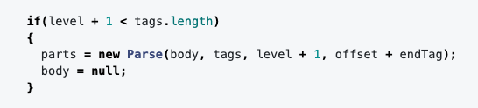
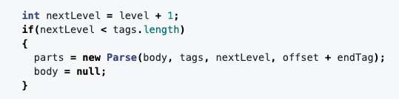
Understandability tips
Encapsulate boundary conditions. Boundary conditions are hard to keep track of. Put the processing for them in one place.
Bad
Good

Slide 19
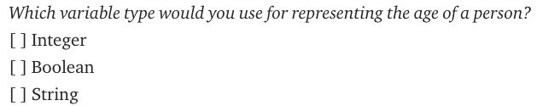
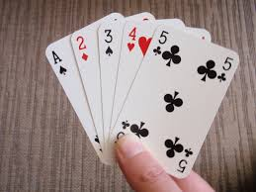
Understandability tips
Prefer dedicated value objects to primitive type.
Value Object
Immutability
Value Equality
Self Validation

Slide 20

Understandability tips
Avoid logical dependency. Don’t write methods which works correctly depending on something else in the same class.
class Student {
String name = null;
void setName(String name){
this.name = name;
}
void printName(){
print(this.name);
}
}

Slide 21
Understandability tips
Avoid negative conditionals.
if(student.isGood())
???
if(!student.isNotGood())

Slide 22
Clean code
Name rules

Slide 23
Names rules
Choose descriptive and unambiguous names.
Make meaningful distinction.
Use pronounceable names.
Use searchable names.
Replace magic numbers with named constants.
Avoid encodings. Don't append prefixes or type information.

Slide 24
Clean code
Functions rules

Slide 25
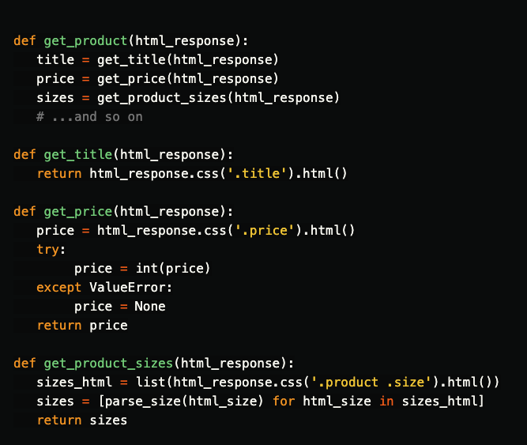
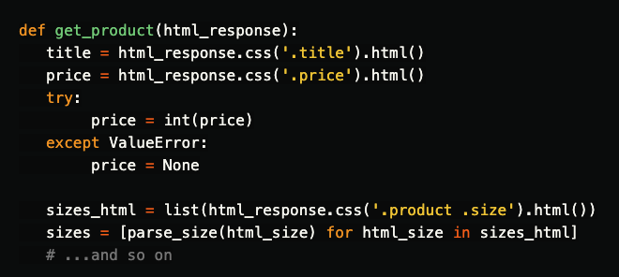
Functions rules
Small.

Slide 26
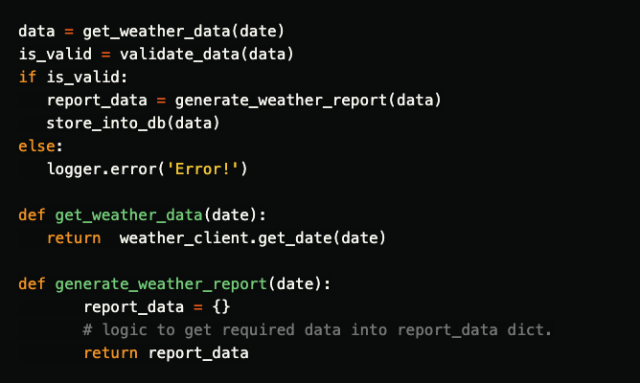
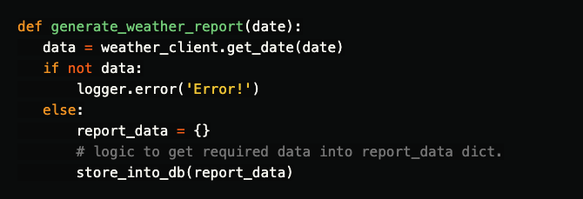
Functions rules
Do one thing.

Slide 27
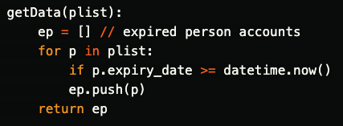
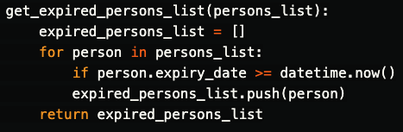
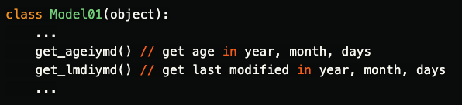
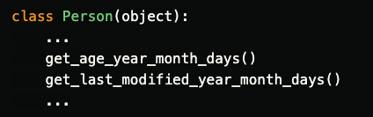
Functions rules
Use descriptive names.

Slide 28
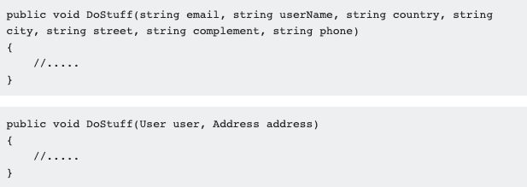
Functions rules
Prefer fewer arguments.
As Uncle Bob said, three is the maximum arguments acceptable.

Slide 29
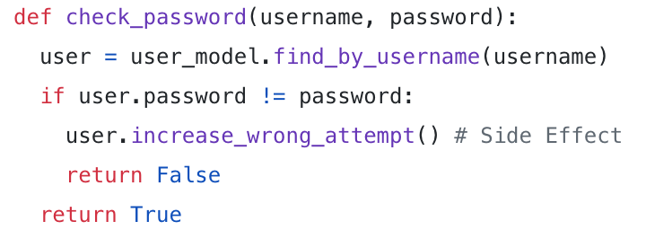
Functions rules
Have no side effects.
Notes:
Không có tác dụng phụ.

Slide 30
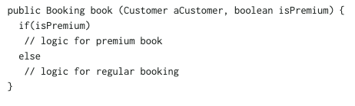
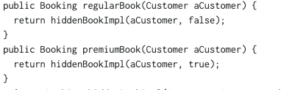
Functions rules
Don't use flag arguments. Split method into several independent methods that can be called from the client without the frag.

Slide 31
Clean code
Comments rules

Slide 32
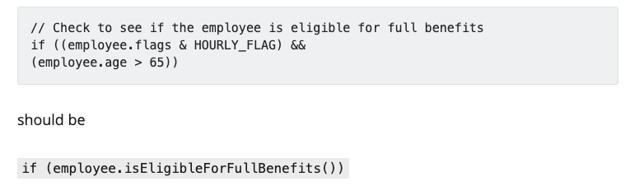
Comments rules
Always try to explain yourself in code.

Slide 33
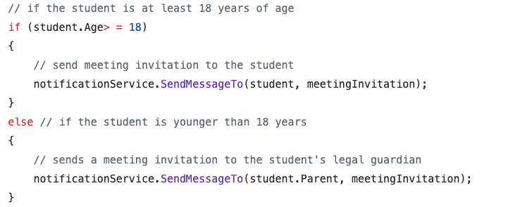
Comments rules
Don’t be redundant
Notes:
Đừng thùa

Slide 34
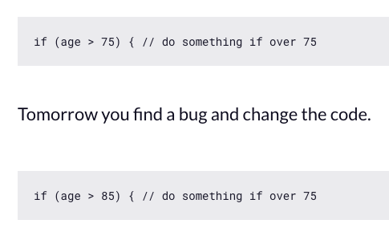
Comments rules
Don’t add obvious noise.
Notes:
Đừng bình luận rõ ràng

Slide 35
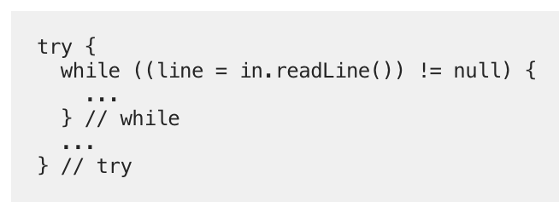
Comments rules
Don't use closing brace comments.

Slide 36
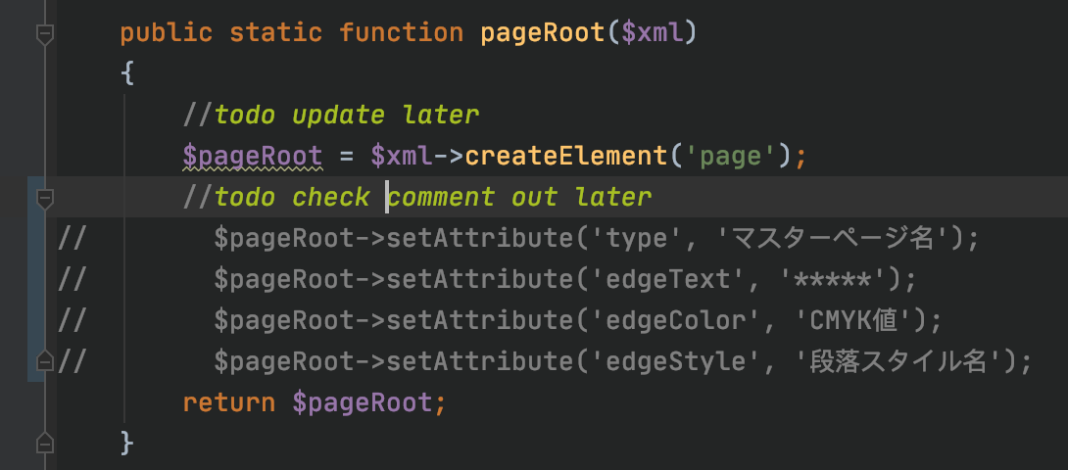
Comments rules
Don't comment out code. Just remove.

Slide 37

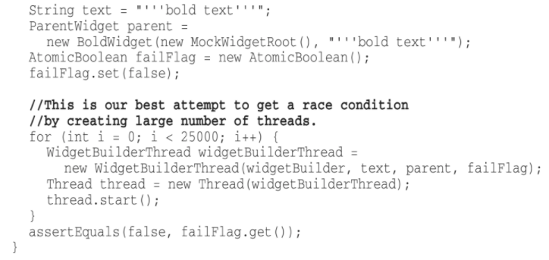
Comments rules
Use as explanation of intent.

Slide 38
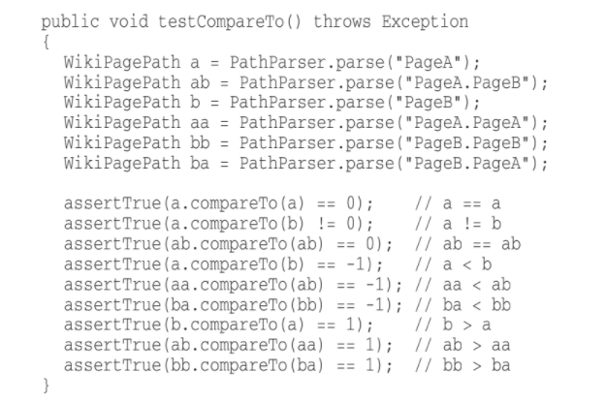
Comments rules
Use as clarification of code.

Slide 39
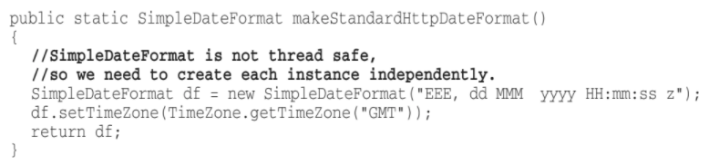
Comments rules
Use as warning of consequences.

Slide 40
Clean code
Objects and data structures
Notes:
Objects hide their data behind abstractions and expose functions that operate on that data. Data structures expose their data and have no meaningful functions. We should be asking objects to do something, we should not be asking it about its internals.

Slide 41
Objects and data structures
Hide internal structure.
class Teacher {
String name = …
void printInformation(){ ...
}
}
class ClassRoom {
Teacher teacher = new Teacher();
void getTeacher(){
return teacher;
}
}
ClassRoom classRoom = new ClassRoom(); classRoom.getTeacher().printInformation();
???
How to hide internal structure ?

Slide 42
Objects and data structures
Prefer data structures.
Class Profile{
String name = …
String age = …
String sex = …
}
Class SchoolReport{
String maths = …
String literature = …
String physics = …
}
class Student{
Profile profile;
SchoolReport schoolReport;
String printInformation()
double getAverageScore()
}
class Student{
String name = …
String age = …
String sex = …
String maths = …
String literature = …
String physics = …
…
String printInformation()
double getAverageScore()
}

Slide 43
Objects and data structures
Avoid hybrids structures (half object and half data).
class Student{
String name = …
String age = …
String sex = …
String maths = …
String literature = …
String physics = …
…
String printInformation()
double calculateAverageScore()
}

Slide 44
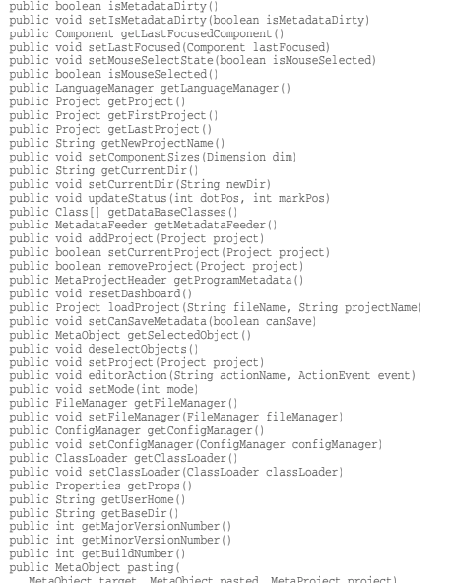
Objects and data structures
Should be small.
How to make object/data structures smaller?

Slide 45
Objects and data structures
Do one thing.
Class Profile{
String name = …
int age = …
String sex = …
}
Class SchoolReport{
int maths = …
int literature = …
int physics = …
}
Class StudentData{
String name = …
int age = …
String sex = …
int maths = …
int literature = …
int physics = …
}
Class SchoolReportFileManager{
SchoolReport readSchoolReportFromFile();
void writeSchoolReportToFile(SchoolReport schoolReport); }
Class Student{ Profile profile; SchoolReport schoolReport;
void calculateAverageScore(); void updateMathsScore(int maths);
void updateMathsScore(int maths);
}
Class Student{ Profile profile; SchoolReport schoolReport;
void readSchoolReportFromFile();
void writeSchoolReportToFile(); void calculateAverageScore(); void updateMathsScore(int maths);
void updateMathsScore(int maths);
}

Slide 46
Objects and data structures
Small number of instance variables
Class Profile{
String name = …
int age = …
String sex = …
}
Class SchoolReport{
int maths = …
int literature = …
int physics = …
}
Class Student{ String name = …
int age = …
String sex = …
int maths = …
int literature = …
int physics = …
void readSchoolReportFromFile();
void writeSchoolReportToFile(); void calculateAverageScore(); void updateMathsScore(int maths);
void updateMathsScore(int maths);
}
Class SchoolReportFileManager{
SchoolReport readSchoolReportFromFile();
void writeSchoolReportToFile(SchoolReport schoolReport); }
Class Student{ Profile profile; SchoolReport schoolReport;
void calculateAverageScore(); void updateMathsScore(int maths);
void updateMathsScore(int maths);
}

Slide 47
Objects and data structures
Base class should know nothing about their derivatives
Class Member{
void getGiftcard(){
if(this instanceof GoldMember){
return ...
}
if(this instanceof NormalMember){
return ...
}
}
} Class GoldMember extends Member{} Class NormalMember extends Member{}

Slide 48
Objects and data structures
Better to have many functions than to pass some code into a function to select a behavior
void execute(Member member, int maths, int physics, int literature){
if(member.isTeacher()) return;
if(!checkPass()) return;
calculateAverageScore(maths, physics, literature);
}
bool checkPass(int maths, int physics, int literature){
Return maths > 5 && physics > 5 && literature > 5;
}
int calculateAverageScore(int maths, int physics,
int literature){
return (maths + physics + literature)/3;
}
int calculateAverageScore(Member member, int maths, int physics, int literature){
if(member.isTeacher()){
return 0; // if == 0 -> isTeacher
}else{
if(maths < 5 || physics < 5 || literature < 5){
return -1; // if < 0 -> fail
}else{
return (maths + physics + literature)/3;
}
}
}

Slide 49
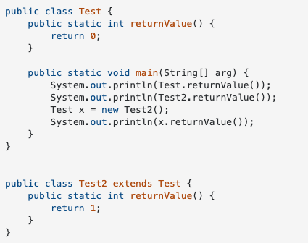
Objects and data structures
Prefer non-static methods to static methods.
What’s different between static methods and non-static methods ?

Slide 50
Clean code
Tests
Notes:
Objects hide their data behind abstractions and expose functions that operate on that data. Data structures expose their data and have no meaningful functions. We should be asking objects to do something, we should not be asking it about its internals.

Slide 51
Tests
One assert per test.
Readable.
Fast.
Independent.
Repeatable.

Slide 52
Clean code
Code smells
Notes:
Objects hide their data behind abstractions and expose functions that operate on that data. Data structures expose their data and have no meaningful functions. We should be asking objects to do something, we should not be asking it about its internals.

Slide 53
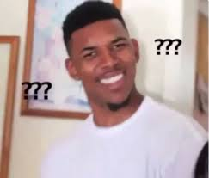
Code smells
Rigidity. The software is difficult to change. A small change causes a cascade of subsequent changes.
Class Animal{
Val cat = {legs: 4, fly: false}
Val bird = {legs: 2, fly: true}
Val elephant = {legs: 4, fly: false}
}
Class AnimalLegManager{
Animal animal = new Animal();
Void totalLegs(){
return animat.cat.legs + animal.bird.legs + animal.elephant.legs;
}
}
Class AnimalFlyManager{
Animal animal = new Animal();
int countAnimalCanFly(){
var count = 0;
if(cat.fly) count++;
if(bird.fly) count++;
if(elephant.fly) count++;
return count;
}
}
Hey, I want to add dog to system. How long you can finish ?
I can do it in 3 days.
WTF
Notes:
Cứng nhắc.

Slide 54
Code smells
Fragility. The software breaks in many places due to a single change.
Class Page1{
void notifyTimeUp(){
sendEvent(‘timeUp’, score);
}
}
Class Page2{
listenEvent(event){
if(event.name == ‘timeUp’){
...
}
}
}
Class Page3{
listenEvent(event){
if(event.name == ‘timeUp’){
...
}
}
}
Class Key{
static String EVENT_TIMEUP = ‘timeUp’;
}
Class Page1{
void notifyTimeUp(){
sendEvent(Key.EVENT_TIMEUP, score);
}
}
Class Page2{
listenEvent(event){
if(event.name == Key.EVENT_TIMEUP){...}
}
}
Class Page3{
listenEvent(event){
if(event.name == Key.EVENT_TIMEUP){...}
}
}
Notes:
Mong manh

Slide 55
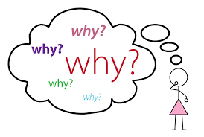
Code smells
Immobility. You cannot reuse parts of the code in other projects because of involved risks and high effort.
Can you reuse “code base” from your last project?
Can you reuse “TimeHelper” from your last project?
This project just the same with ‘ABC’ project. Can we reuse any code from it?
No, I think code from scratch is faster.
Notes:
Bất động.

Slide 56

Code smells
Needless Complexity.
Design contains elements that are not currently useful currently useful
Too much anticipation of future needs
Developers try to protect themselves against probable future changes
Extra complexity is needed only when designing an application framework or customizable component.
Notes:
Thiết kế chứa các yếu tố hiện không hữu ích hiện hữu ích
Dự đoán quá nhiều về nhu cầu trong tương lai
Các nhà phát triển cố gắng tự bảo vệ mình trước những thay đổi có thể xảy ra trong tương lai
các nguyên tắc nhanh nhẹn tuyên bố rằng bạn không bao giờ nên đoán trước các nhu cầu trong tương lai
Chỉ cần thêm độ phức tạp khi thiết kế khung ứng dụng hoặc thành phần có thể tùy chỉnh.
Dấu hiệu cho biết: đầu tư vào sự không chắc chắn

Slide 57
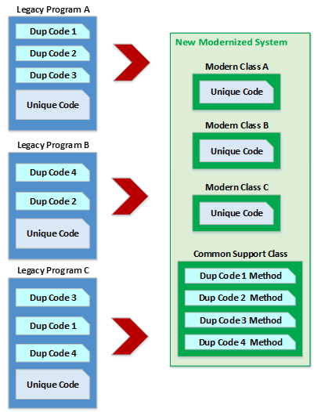
Code smells
Needless Repetition.
The design contains repeating structures that could be unified under a single abstraction
The problem is due to developer’s abuse of cut and paste.
It is really hard to maintain and understand the system with duplicated code.
Notes:
Cứng nhắc.

Slide 58
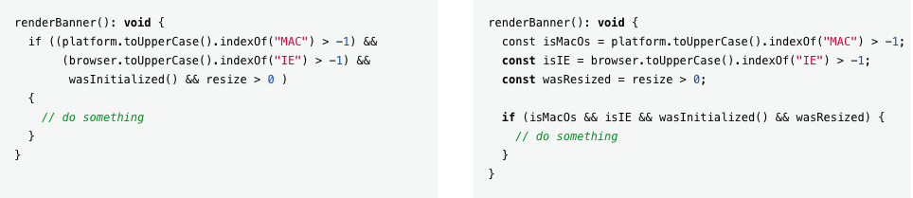
Code smells
Opacity. The code is hard to understand.
Notes:
Cứng nhắc.

Slide 59

THANK YOU

